Slide 1
PREDICTING ICU MORTALITY USING PATIENT
DEMOGRAPHICS AND DIAGNOSES
Date: 03/16/2026
GitHub Link:
https://github.com/aali17/PREDICTING-ICU-MORTALITY-USING-PATIENT-DEMOGRAPHICS-AND-DIAGNOSES
Speaker Notes:
Welcome to the tutorial of predicting ICU mortality using patient demographics and diagnoses data
We will use MIMIC IV demo dataset for this tutorial
All codes are written in Jupyter notebook and available in the github link provided

Slide 2
Learning Objectives
Load and merge MIMIC IV tables
Create an ICU patient cohort
Extract features from diagnosis codes
Build and compare ML models
Handle class imbalance in medical data
Interpret results clinically
Speaker Notes:
This tutorial will help with hands on learning
Primary focus will be on the demographics (age and gender) and diagnoses (ICD codes)
By the end of this tutorial, you will learn how to create a mortality prediction model

Slide 3
Dataset: MIMIC-IV Demo
Files used in this tutorial:
patients.csv (Demographics - age, gender)
admissions.csv (Mortality outcome)
icustays.csv (ICU stay identification)
diagnoses_icd.csv (Diagnosis codes)
d_icd_diagnoses.csv (Code descriptions)
Speaker Notes:
The MIMIC-IV Demo dataset is used which is perfect for learning
Simple analysis is performed to keep the tutorial easy to understand
In your own work, you can use the MIMIC-IV dataset to perform rigorous analysis

Slide 4
ICU Cohort Characteristics
Basic Statistics:
Total ICU stays: 140
Unique patients: 100
ICU mortality rate: 14.3%
ICU Unit Distribution::
Surgical Intensive Care Unit (SICU) 29
Medical Intensive Care Unit (MICU) 29
Cardiac Vascular Intensive Care Unit (CVICU) 25
Medical/Surgical Intensive Care Unit (MICU/SICU) 23
Trauma SICU (TSICU) 16
Coronary Care Unit (CCU) 13
Neuro Surgical Intensive Care Unit (Neuro SICU) 3
Neuro Stepdown 1
Neuro Intermediate 1
Demographics:
• Average age: 62.0 years
• Gender: 57% Male, 43% Female
Speaker Notes:
The patient population and ICU unit distribution is shown above
ICU mortality rate is 14.3%
Most of the patients in the ICU are at old age, mean is 62 years

Slide 5
Comorbidity Prevalence
hypertension: 25.7%
diabetes: 17.9%
heart_failure: 15.0%
copd: 10.7%
renal_failure: 21.4%
liver_disease: 5.7%
cancer: 2.1%
sepsis: 7.1%
pneumonia: 5.0%
mi: 5.7%
Speaker Notes:
Hypertension is most common - affects 1 in 4 ICU patients
Non-survivors have more than double the comorbidities
These differences will help our model predict mortality

Slide 6
Highest Mortality Conditions
Cancer 66.7%
Sepsis 50.0%
Heart Failure 33.3%
Renal Failure 30.0%
Pneumonia 28.6%
Hypertension 25.0%
Speaker Notes:
Cancer patients have the highest risk - 66.7% mortality
Sepsis is also extremely dangerous - 50% mortality
These conditions are known to be life-threatening in ICU
The model will learn these patterns

Slide 7
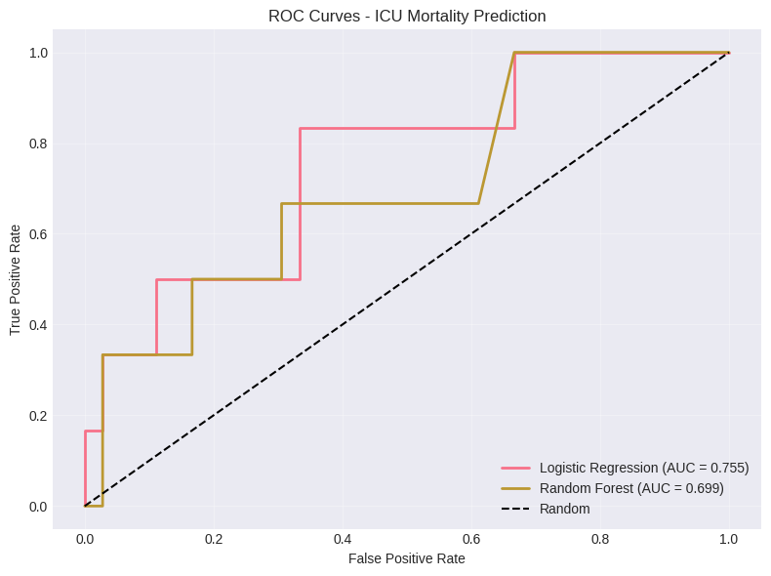
Model Performance Comparison
Speaker Notes:
Methods used in this tutorial – Logistic Regression and Random Forest
Logistic Regression performs better for this task (AUC 0.755)
Random Forest is more accurate overall but misses deaths
We'll use Logistic Regression for interpretation

Slide 8
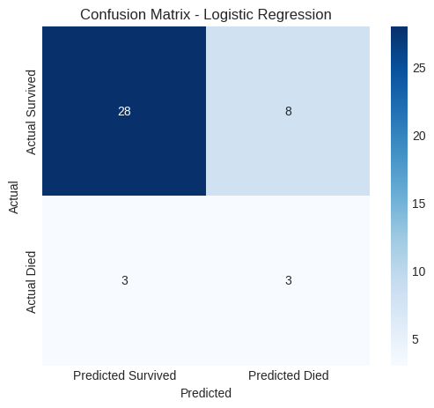
Confusion Matrix
Speaker Notes:
This is how our model performs on unseen test data
42 test patients: 36 survivors, 6 deaths (consistent with 14% mortality)
We caught 3 of 6 deaths (50% recall) - better than random
We missed 3 deaths - these are the patients we'd want to identify

Slide 9
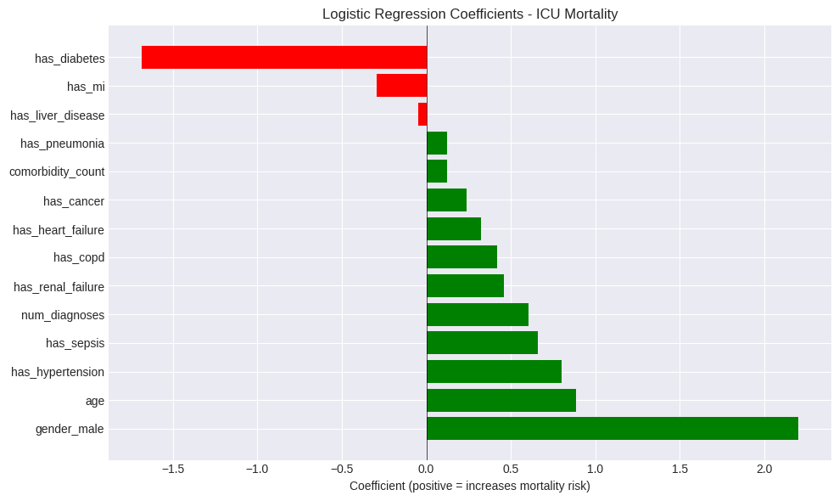
Feature Importance
Speaker Notes:
Male gender is strongest - but this may be dataset specific
Age, hypertension, sepsis all strongly increase risk
Interestingly, diabetes appears protective

Slide 10
Clinical Interpretation
Clinical Interpretation:
Age is a strong predictor of ICU mortality - older patients have significantly higher risk
Comorbidity burden matters - each additional chronic condition increases mortality risk
Specific high-risk conditions identified:
• Cancer: 5.1x higher mortality risk
• Sepsis: 4.3x higher mortality risk
• Heart Failure: 3.1x higher mortality risk
Speaker Notes:
These findings match clinical experience
Older, sicker patients with specific conditions are at highest risk
The model captures these patterns automatically
This could help identify patients for intensive care need

